Slide 1



Slide 2

Early reading
We want our children to have a love for reading that remains with them all of their life. The teaching of early reading and phonics is key to forming that love of reading.

Slide 3
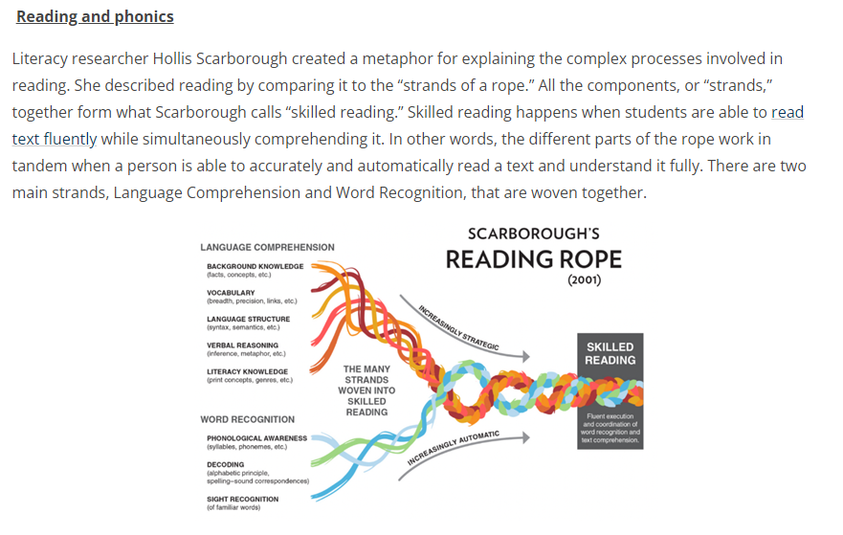

Slide 4
Teaching for word recognition
Now:
Little Wandle assessment identifies all secure sounds and any gaps.
Children embark on a pathway of daily phonic small group sessions or interventions to address gaps.
Weekly rehearsal and practice of sounds alongside comprehension of fully decodable books.
Fully decodable book to read at home.
Accelerated reader shared reading for pleasure.
Previously:
Using assessments at the beginning of the year children were grouped according to their phonic phase knowledge.
Small group or individual work on the needed phase from letters and sounds.
Phonic play and Nessy interventions helped the children practice sounds.

Slide 5
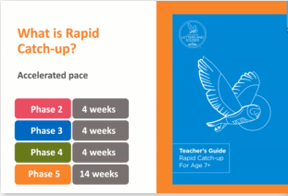
The rapid catch up provision builds on the Little Wandle provision the children have received in the infant school.
Research shows that consistency helps lessen the cognitive load for children. The resources and learning phrases will be the same as those used in the children’s previous experience. This allows them to build rather than learn new ways of remembering letters and sounds.

Slide 6
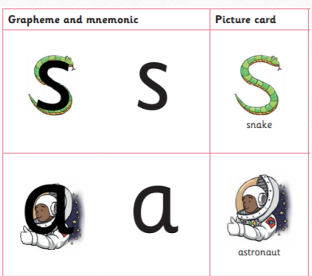
Sounds and learning phrases
Children will learn the sounds using these pictures to prompt them (this can be found on the website)
Each grapheme has a pronunciation phrase (e.g. Show your teeth and let the s hiss out ssssss ssssss) and a formation phrase (e.g. under the snake’s chin, slide down and round its tail)
Many children will recognise these from Shinfield Infants.

Slide 7
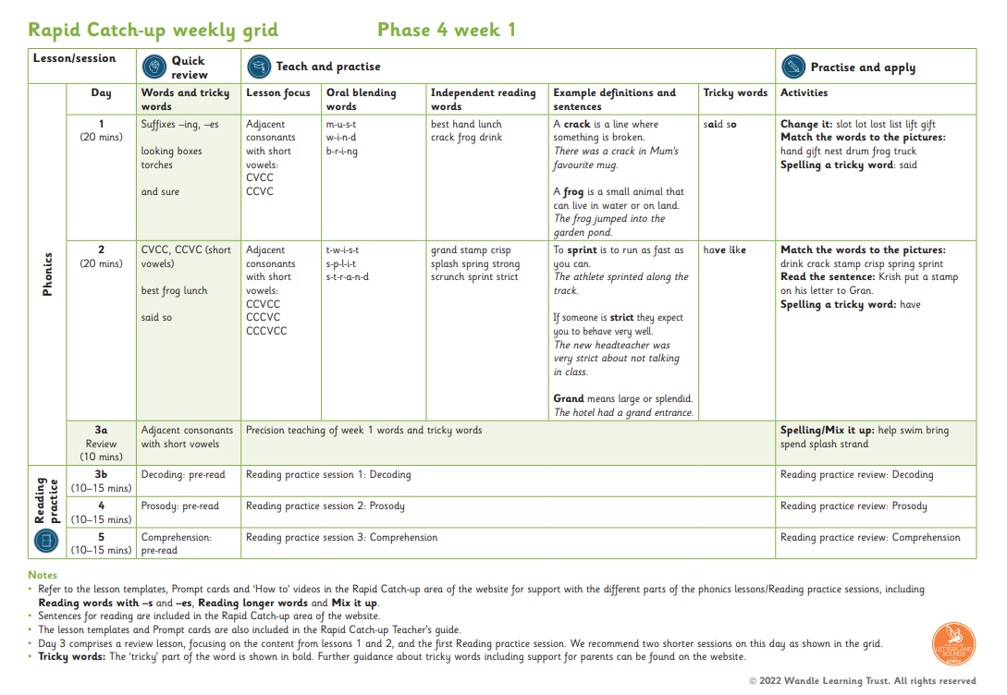

Slide 8
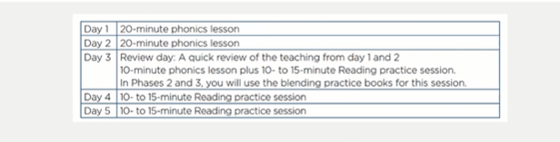

Weekly lesson plan
Phonic lessons comprise of
a quick review
Teach and practise
Practise and apply

Slide 9
Reading books
Reading practice sessions Children will read 3 times per week on the same book focusing on different skills:
-Decoding -Prosody (expression) -Comprehension
They will have online access to a decodable book that contains words with the same focus sounds as the book they have been reading in school. They will keep this book for a week. You can use the prompts inside the front and back cover to support your child as they read.
This book is matched to your child’s phonic ability and should be fluent and automatic. The aim is that the children read at a 95% fluency. This means that the children should need little to no support reading the words. We assess them every 4 weeks to match their reading ability to the right book. They will also continue to use accelerated reader from enjoyment of reading though these will not be fully decodable and children should not be expected to read these on their own.

Slide 10
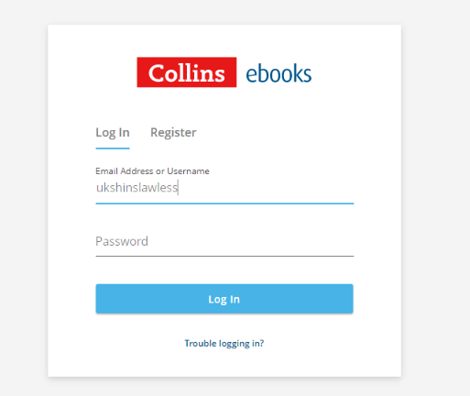
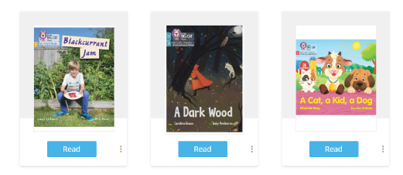
Accessing the books at home
All children have a username and unique password to access the online version of their group book from the collins ebook library. Please see your teacher if you cannot access the resource.

Slide 11
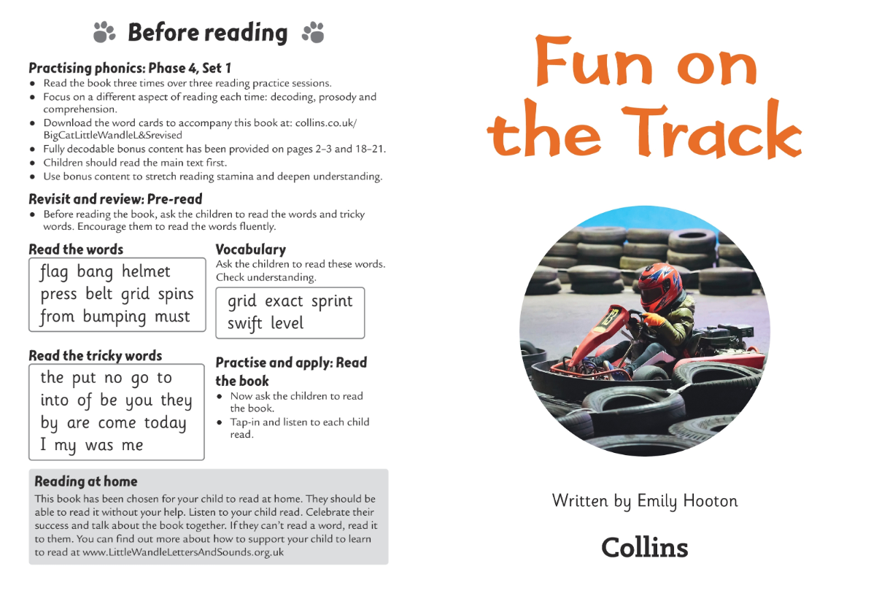

Slide 12
What can you do to help at home?
Please look at the Little Wandle videos and guidance for parents
https://www.littlewandlelettersandsounds.org.uk/resources/for-parents/
Support children in learning the alphabetic code
Let your child “show off” their reading to you and celebrate and praise all the way!
Share books with your children for pleasure and read their accelerated reader books with them.

Slide 13


Slide 14
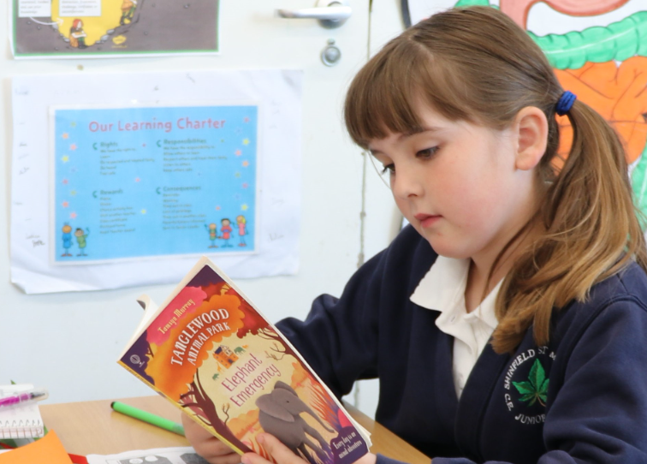
Thanks!
Any questions?
Please speak to your class teacher for more information if needed.

